Slide 1


Analysis (EDA) Data-Related Job Vacancy
Data Source : jobstreet.com
Region : Indonesia
Jeremy Adi Padma Nagara
linkedin.com/in/jeremy-adi/
github.com/Jeremy-Adi

Slide 2
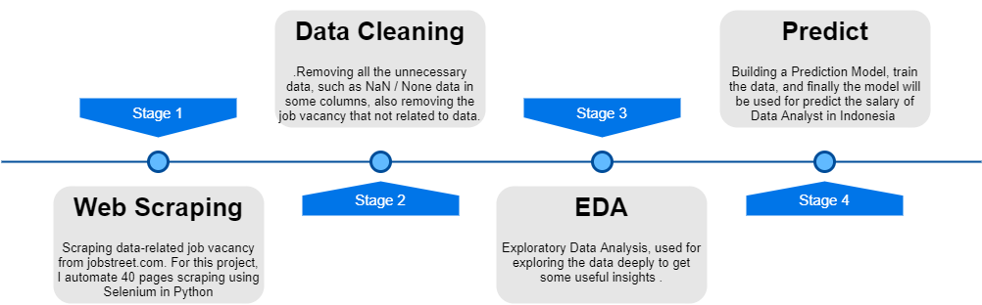
Flow Chart

Slide 3
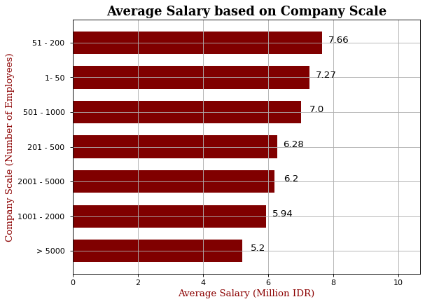
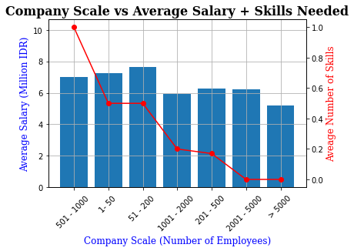
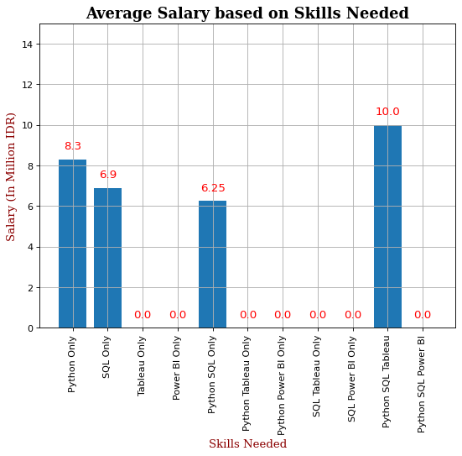
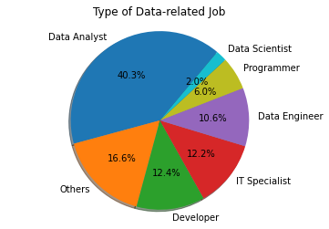
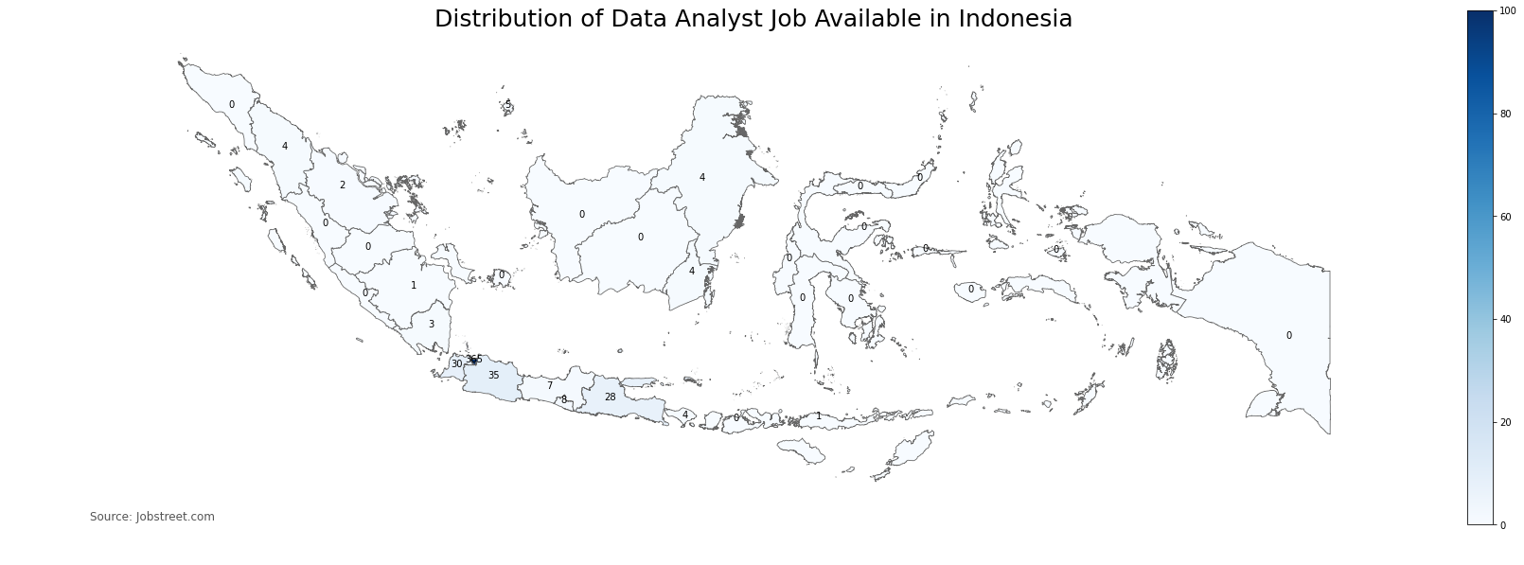
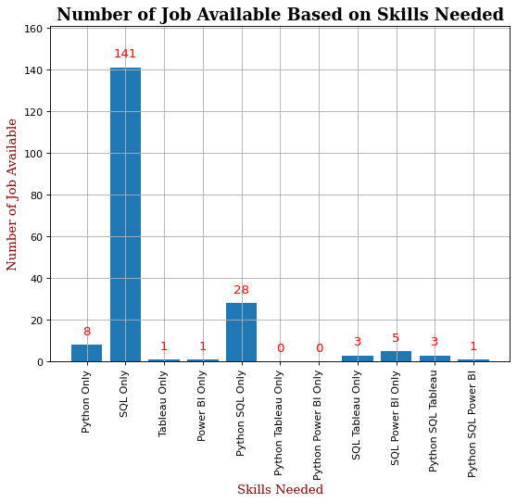
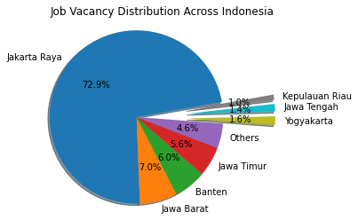
Total Data
Salary Related
Skills Related
501
Job Type Distribution

Slide 4
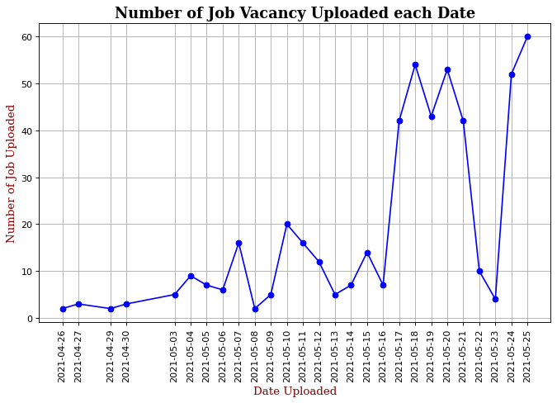
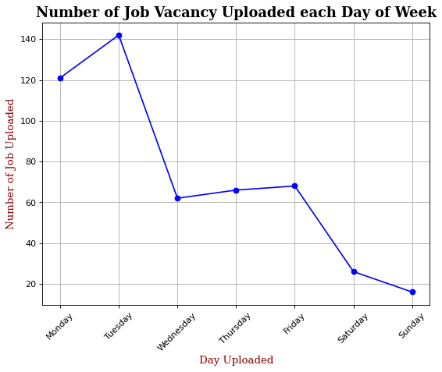
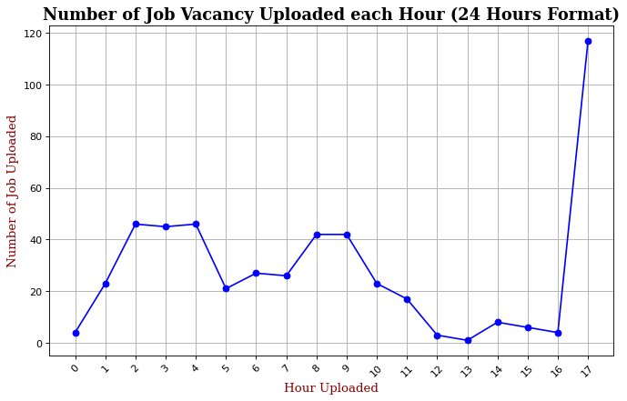
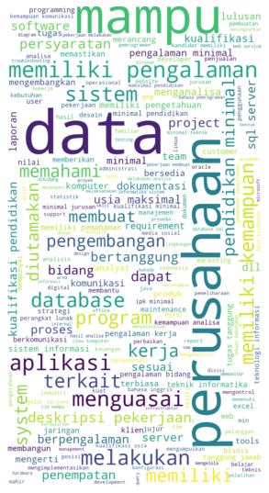

Uploaded Time vs Number of Job
Salary Prediction
IDR 7.04 M/month
Entry-Level
Based on Random Forest Prediction
Salary Basic Stats (Million IDR)
MIN | 10% | MEDIAN | 90% | MAX
3 | 4.615 | 6.95 | 12 | 15
Common Keyword

